Slide 1


A SQL PROJECT
Carbon Emission Calculator

Slide 2


Executive Summary
The Carbon Emission Calculator project is designed to analyze and quantify carbon emissions produced from various human and organizational activities such as transportation, energy consumption, and waste generation. By leveraging SQL-based data processing, the project provides clear insights into emission patterns, identifies high-impact activities, and supports sustainability-focused decision-making. This analytical framework helps organizations track their carbon footprint and develop strategies for reducing greenhouse gas emissions.

Slide 3
Key Highlights :
Comprehensive SQL-driven analysis of activity-level carbon emissions
Identification of top emitting users, activities, and countries
Daily, weekly, and category-based emission trend monitoring
Percentage contribution analysis to highlight high-impact sources
Data-backed carbon reduction recommendations
Clean and scalable database schema for environmental analytics

Slide 4
Business Objectives & Problem Statement
Problem Statement:
Organizations and individuals lack clear visibility into the sources contributing most to their carbon footprint. Without proper tracking and analysis, sustainable decision-making becomes challenging.
Objectives:
Measure carbon emissions across multiple activity categories.
Identify major emission hotspots and target reduction areas.
Analyze daily and regional emission trends for planning.
Provide actionable recommendations based on SQL insights.
Enable eco-friendly decision-making supported by data analysis.

Slide 5
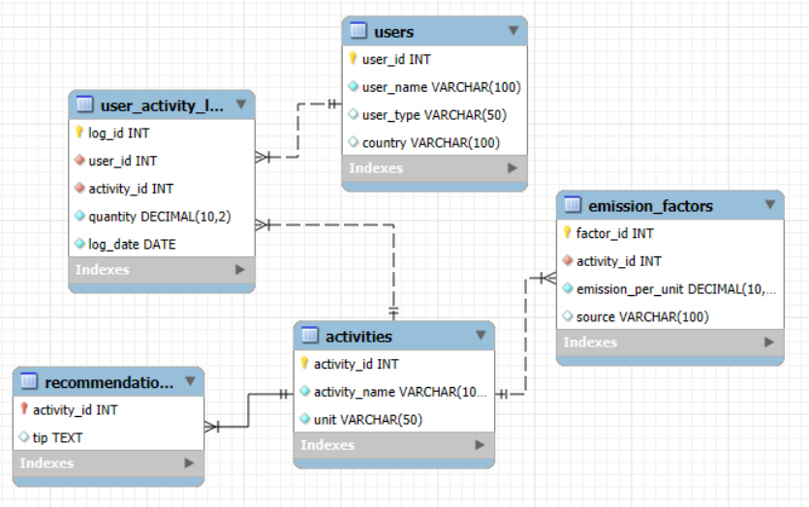
Data Model & ER Diagram

Slide 6
Data Analysis Approach
Data Modeling: Designed relational tables for users, activities, emission rates, logs, and recommendations.
Data Cleaning: Structured numeric fields, standardized units, ensured referential integrity.
Exploratory SQL Analysis: Executed SELECT, JOIN, GROUP BY, HAVING, and aggregate queries.
Insight Extraction: Identified patterns such as high-emission activities, top emitters, and country-level trends.
Recommendation Framework: Mapped activity emissions with relevant reduction strategies.

Slide 7
Content / Queries of Project
The project includes 14 core SQL queries, covering:
Listing users, activities, and emission factors
Calculating total CO₂ emissions per user
Total and average emissions per activity type
Daily and country-level emission tracking
Identifying highest contributing activities & users
Total emission by country
Daily Emission Trend for a Specific User
Percentage contribution of each activity
Emission reduction recommendations via SQL joins
High-emitting users (daily > 500 kg)
Average emission by user type (individual vs company)
Each query includes:
SQL code
Output
Explanation of logic
Insight derived

Slide 8



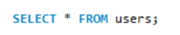
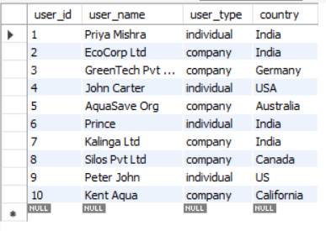
1. List all users and their types
Explanation:
Retrieves every user’s basic info — useful for understanding dataset composition.
Insight:
You can easily see how many individuals vs. companies are contributing to emissions.

Slide 9

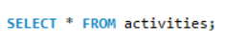
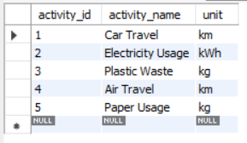
2. Show all activities and their units
Explanation:
Displays what types of activities produce emissions and their measurement units.
Insight:
Helps you confirm the scale (e.g., km for travel, kWh for electricity) before calculating emissions.

Slide 10
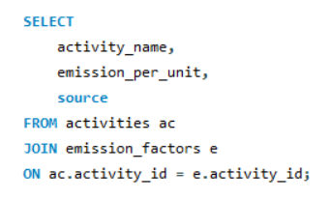
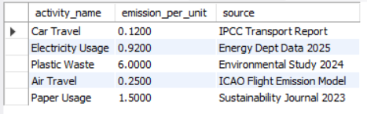
3. Display emission factor for every activity
Explanation:
Shows how much CO₂is emitted per unit
of each activity.
Insight :
Helps to prioritize activities that
are more carbon-intensive per unit (like plastic waste).

Slide 11
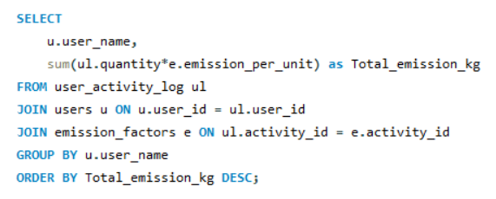
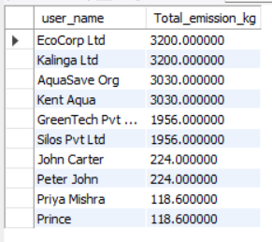
4. Calculate total CO₂emission per user
Insight :
You can identify which user or company has the largest carbon footprint.
Explanation:
Multiplies activity quantity by emission factor and sums up per user.

Slide 12
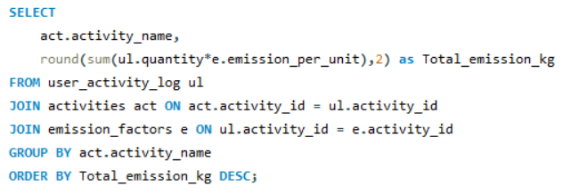
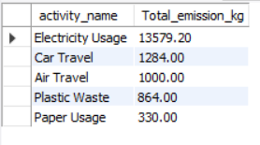
5. Total carbon emission per activity type
Insight :
Reveals which activities tend to produce high emissions at total — e.g., electricity use or travel.
Explanation:
Total emission levels for each activity across all users.

Slide 13
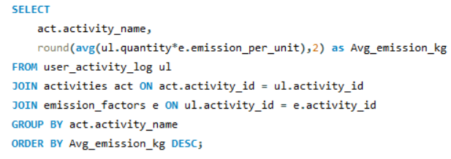
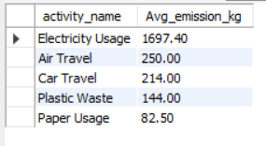
6. Find average emission per activity type
Explanation:
Averages emission levels for each activity across all users.
Insight :
Reveals which activities tend to produce high emissions on average — e.g., electricity use or travel.

Slide 14
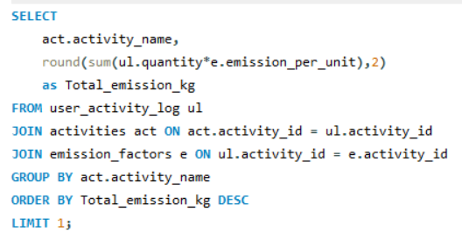
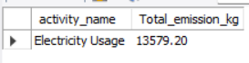
7. Show the activity contributing the most to total emissions
Explanation:
Calculates total emissions by activity and picks the top one.
Insight :
Highlights the main cause of carbon footprint (e.g., electricity may dominate overall).

Slide 15
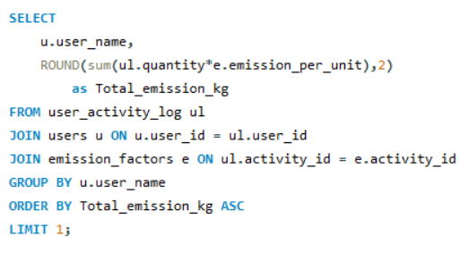
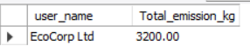
8. Identify the user who emitted the highest CO₂
Explanation:
Ranks emissions ascendingly to find the most eco-friendly user.
Insight:
Could be an individual with maximum activities — a benchmark for emission generation.

Slide 16
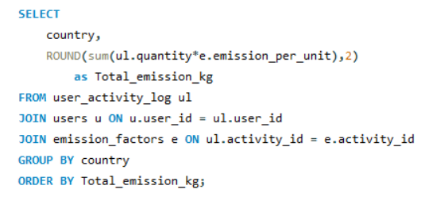
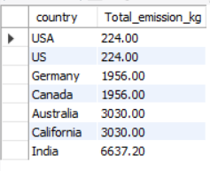
9. Find total emission by country
Insight :
Useful for environmental reporting — shows which regions need more emission control efforts.
Explanation:
Aggregates emission totals by country.

Slide 17
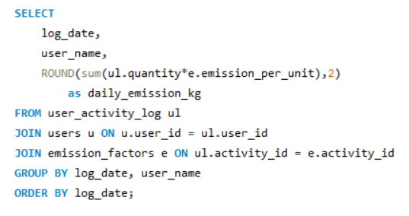
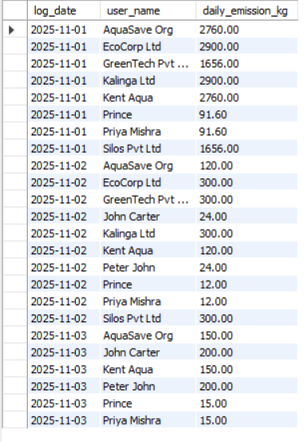
10. Calculate Daily Emission Trend for a Specific User
Explanation:
Summarizes emissions by date.
Insight:
Helps identify peak emission days, useful for monitoring patterns or special events.

Slide 18

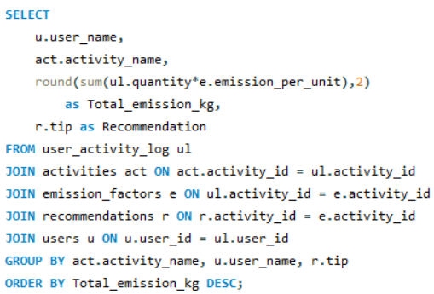
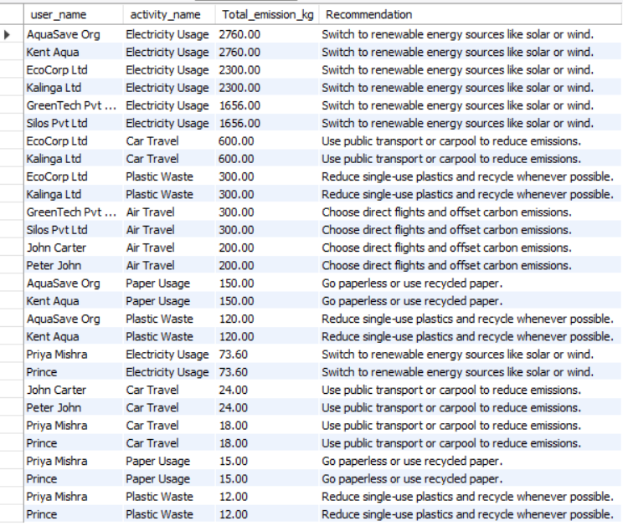
11. Emission Reduction Recommendations to users by activity type
Insight :
Helps users to understand and apply the solution.
Explanation:
Give tip to cut down the emission amount through activity by user.

Slide 19
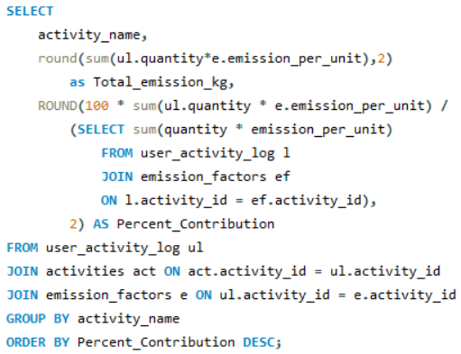
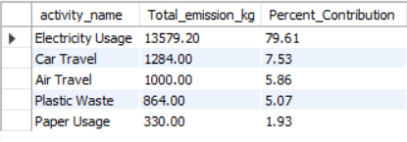
12. Find percentage contribution of each activity to total emissions
Explanation:
Divides each activity’s emission by the global total to get contribution percentage.
Insight:
Identifies the most significant emission source, e.g., 79% from electricity.

Slide 20
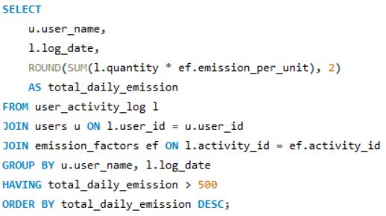
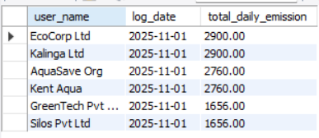
13. List users with daily emissions greater than 500 kg CO₂
Explanation:
Aggregates daily emission totals per user and filters with HAVING.
Insight:
Identifies heavy emitters on specific days — good for daily reporting.

Slide 21
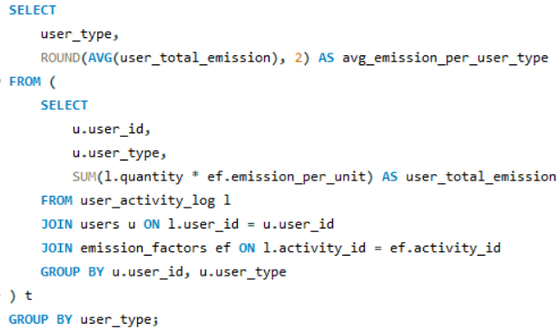
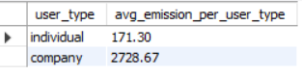
14. Average emission per user type (individual vs company)
Explanation:
First computes total emission per user, then averages by user type.
Insight:
Shows that companies typically emit much more than individuals — confirming large-scale operational impact.

Slide 22


Business Insights & Recommendations
Key Insights :
Electricity usage and transport are the largest emission contributors.
Companies emit significantly more than individuals due to larger operations.
Certain countries and regions show disproportionately high emission levels.
Peak emission days indicate operational spikes or high-usage patterns.
Recommendations :
Shift to renewable energy sources to reduce electricity-related emissions.
Promote public transport, carpooling, and EV adoption to minimize travel-based emissions.
Encourage organizations to monitor and reduce operational inefficiencies.
Implement regular carbon audits and dashboard monitoring.
Provide personalized reduction tips based on user activity logs.

Slide 23


Future Scope
Integration of real-time IoT data from smart meters, vehicles, and sensors.
Development of predictive models for forecasting future emissions.
Visualization dashboards using Power BI / Tableau.
Machine learning suggestions for personalized reduction strategies.
Expansion into renewable energy tracking & carbon credit management.
API-based integration for large-scale organizational deployment.

Slide 24
CONCLUSION
The SQL-based Carbon Emission Calculator delivers a structured and analytical approach for evaluating carbon footprints across diverse activities. By organizing data into a clear schema and executing detailed emission queries, the project provides valuable insights for sustainability planning. The findings support environmental responsibility by identifying actionable opportunities for reducing overall carbon output.

Slide 25

THANK YOU
Any
Questions ?

